Slide 1

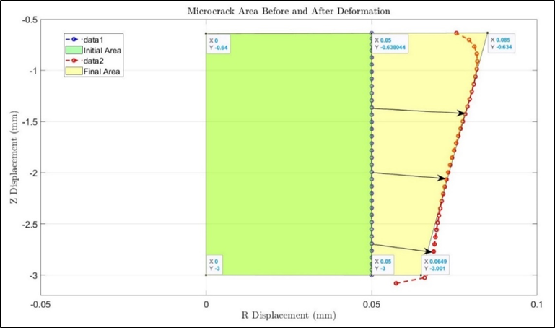
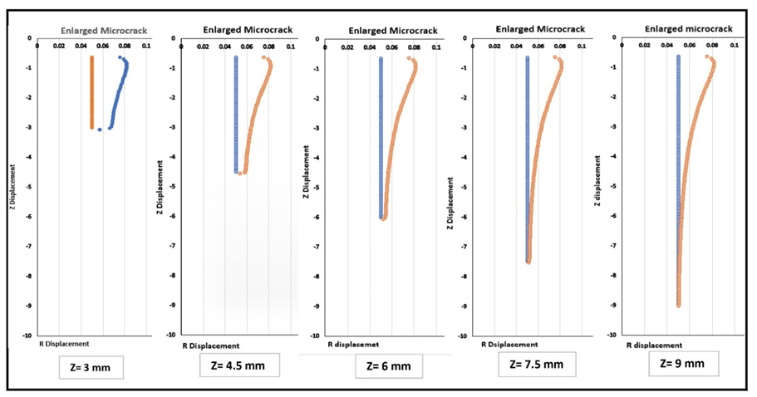
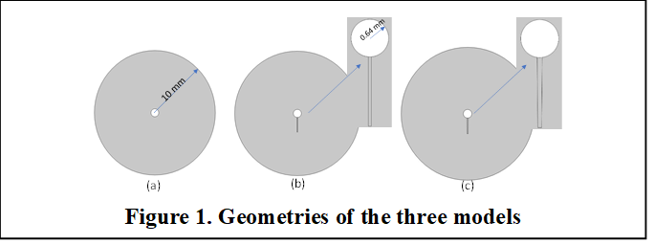
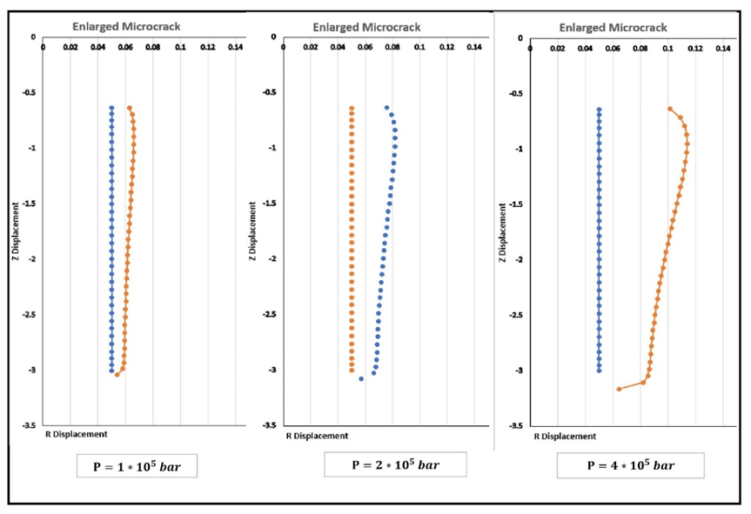
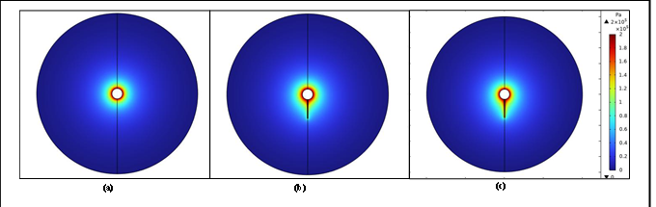
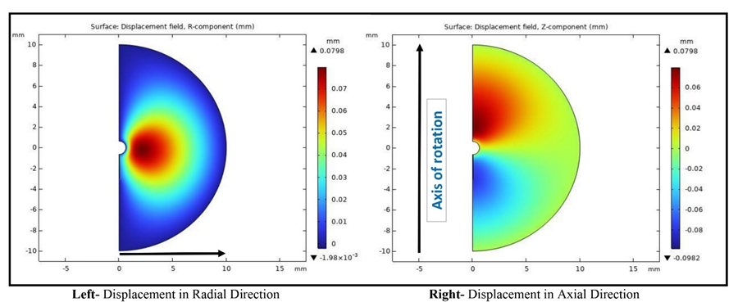
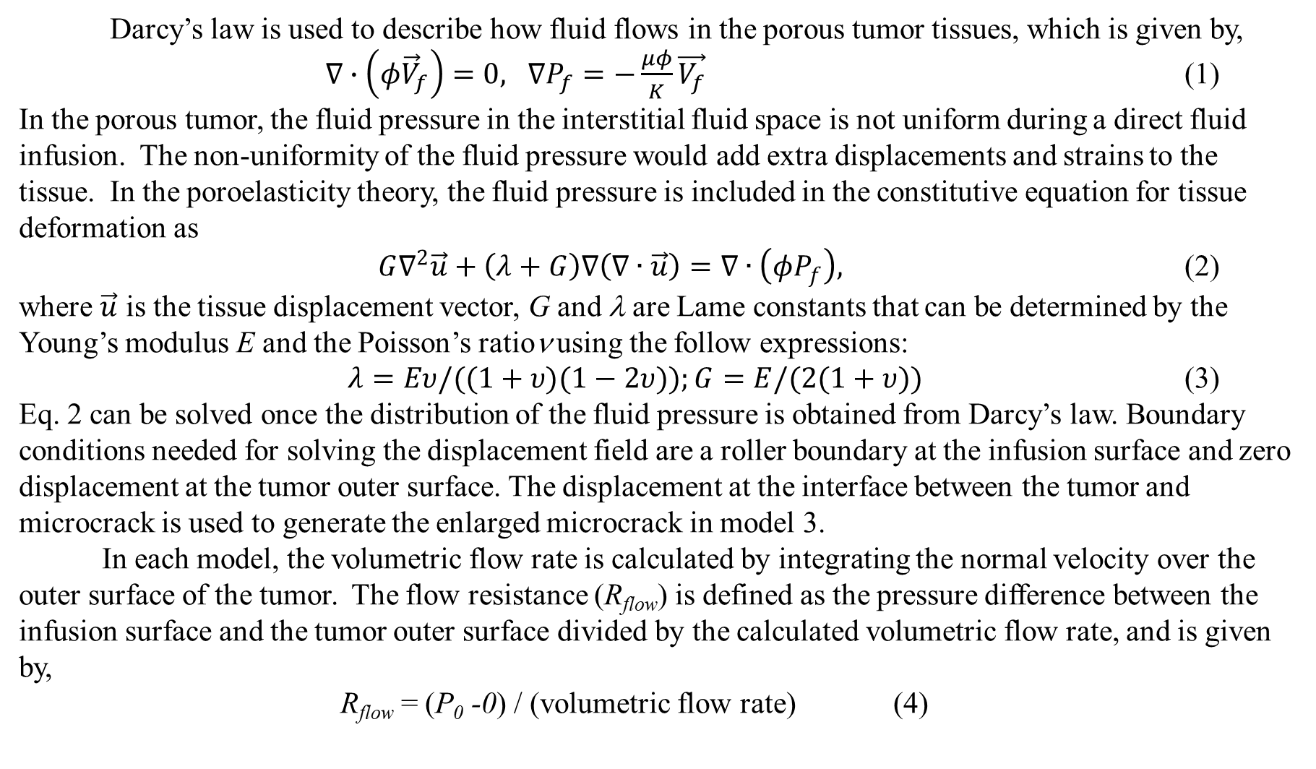
Enhancing Fluid Infusion via introduction and Enlargement of microcracks in tumors – Theoretical Simulations
Md Jawed Naseem, Ronghui Ma, and Liang Zhu
Department of Mechanical Engineering, University of Maryland Baltimore County Baltimore, MD, USA
SB3C 2024 abstract # 243
INTRODUCTION
In chemical ablation of tumors, convection-enhanced delivery (CED) is commonly used to infuse chemicals such as ethanol via a single cannula inserted into tumors. Unfortunately, very high interstitial fluid pressure (IFP) and small porosity in tumors often cause backflow through the needle track. This leads to leakage of the chemicals to surrounding healthy tissue, resulting in collateral damage or severe pain to patients. In recent years, novel devices have been manufactured to incorporate retractable tines. The original design aimed at using the tines for infusion and the retract ability of the tines allows more infusing sites to enlarge the infused tissue volume. Previous experiments using ethanol for liver tumor ablation demonstrated less pain experienced by patients, implying less leakage¹. None of the previous studies evaluated a CED system with a retractable needle only for generating microcracks in tumors and the resulting change of flow resistance in tumors during direct fluid infusion.
In this study, we perform theoretical simulation to evaluate how introduction of a microcrack in tissue reduces the overall flow resistance in a porous tumor, as well as further decrease in the flow resistance as this microcrack enlarges in a direct infusion process using CED. Both Darcy’s law and the poroelasticity theory are used in the simulation to understand the fluid transport in porous tumors with or without microcrack introduction and/or enlargement. We expected that the study would provide quantitative measures to evaluate whether this approach is effective to enhance the fluid transport in dense porous tumors.
METHODS
Figure 4 Enlarged view of the frustum-shaped crack generated using curve fitting in EXCEL.
Figure 5. Original (the straight line) and the deformed (the curved line) interface between the crack and the tumor, as affected by the length of the microcrack.
Darcy’s law is used to describe how fluid flows in the porous tumor tissues, which is given by,
$∇∙\left(φ{\vec{V}}_{f}\right)=0, ∇P_{f}=−\frac{μφ}{Κ}\vec{V_{f}}$ (1)
In the porous tumor, the fluid pressure in the interstitial fluid space is not uniform during a direct fluid infusion. The non-uniformity of the fluid pressure would add extra displacements and strains to the tissue. In the poroelasticity theory, the fluid pressure is included in the constitutive equation for tissue deformation as
$G∇^{2}\vec{u}+\left(λ+G\right)∇\left(∇∙\vec{u}\right)=∇∙\left(φP_{f}\right),$ (2)
where $\vec{u}$ is the tissue displacement vector, G and λ are Lame constants that can be determined by the Young’s modulus E and the Poisson’s ratioν using the follow expressions:
$λ=Eυ/((1+υ)(1−2υ));G=E/(2(1+υ))$ (3)
Eq. 2 can be solved once the distribution of the fluid pressure is obtained from Darcy’s law. Boundary conditions needed for solving the displacement field are a roller boundary at the infusion surface and zero displacement at the tumor outer surface. The displacement at the interface between the tumor and microcrack is used to generate the enlarged microcrack in model 3.
In each model, the volumetric flow rate is calculated by integrating the normal velocity over the outer surface of the tumor. The flow resistance (R_{flow}) is defined as the pressure difference between the infusion surface and the tumor outer surface divided by the calculated volumetric flow rate, and is given by,
R_{flow} = (P₀ -0) / (volumetric flow rate) (4)
Figure 6. Original (the straight line) and the deformed (the curved line) interface between the crack and the tumor, as affected by the infusing pressure varying from 1*10⁵ pa (left) to 4*10⁵ pa (right).
RESULTS
Table 1. Simulation properties and parameters²
μ, Pa s | 0.001 | E_{tumor}, MPa | 0.3
Κ_{tumor}, m² | 5*10⁻¹⁶ | E_{crack}, MPa | 0.003
Κ_{crack}, m² | 2.02*10⁻¹³ | ν_{tumor} | 0.4
φ _{tumor} | 0.2 | ν_{crack} | 0.4
φ _{crack} | 0.8 | ρ, kg/m³ | 1000
Figure 2. Pressure fields in the spherical tumor without microcrack (left), with an un-deformed microcrack of 0.05 mm in radius and 3 mm long (middle) and with an enlarged microcrack.
SUMMARY
The theoretical simulation results have illustrated significantly altered pressure and velocity fields in a porous tumor due to introduction of a microcrack. The non-uniform fluid pressure field enlarges the cylindrical microcrack to a frustum, with a crack volume more than doubled. Due to the large permeability and porosity in the microcrack, flow from the infusion surface to the tumor periphery is much easier than that without microcrack. Overall, the flow resistance with the enlarged microcrack is reduced by up to 20% from the baseline case without introduction of a microcrack. In general, the effect is more evident with a longer microcrack and with a larger infusing pressure. We conclude that introducing a microcrack in porous tumors is an effective way to facilitate fluid flow in porous tumors using CED.
ACKNOWLEDGEMENTS
This research was supported by UMBC.
REFERENCES
[1] Kuang, M et al., Radiology, 253(2):552-561, 2009.
[2] Su, D. Et al., Medical and Biological Engineering & Computing, DOI 10.1007/s11517-011-0819-y, 2011.
Figure 3. The two components of the displacement vector induced by the non-uniform pressure field in the spherical tumor with an un-deformed microcrack of 0.05 mm in radius and 3 mm long.

