Slide 1
Evaluation of Accuracy of Digital Thermometers

Slide 2
Results of Clinical Study Showing Over- and Under-estimation of body Temperature by Store Brand Thermometers

Slide 3
Experimental Setup of a Artificial Human Arm To Evaluate Accuracy of Store Brand Thermometer for Various Conditions

Slide 4
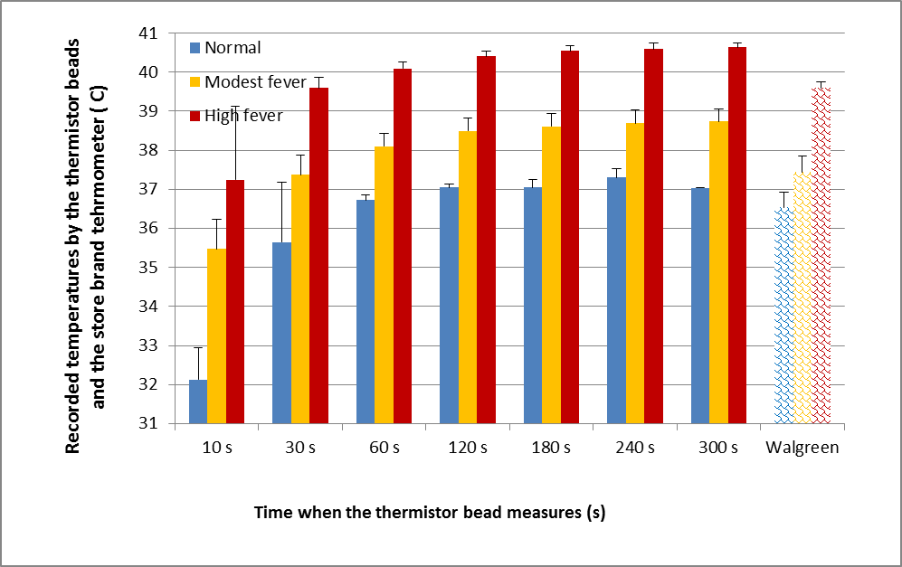
Comparison of Store Brand Thermometers with that by a Thermistor Bead Sensor for Various Conditions

Slide 5
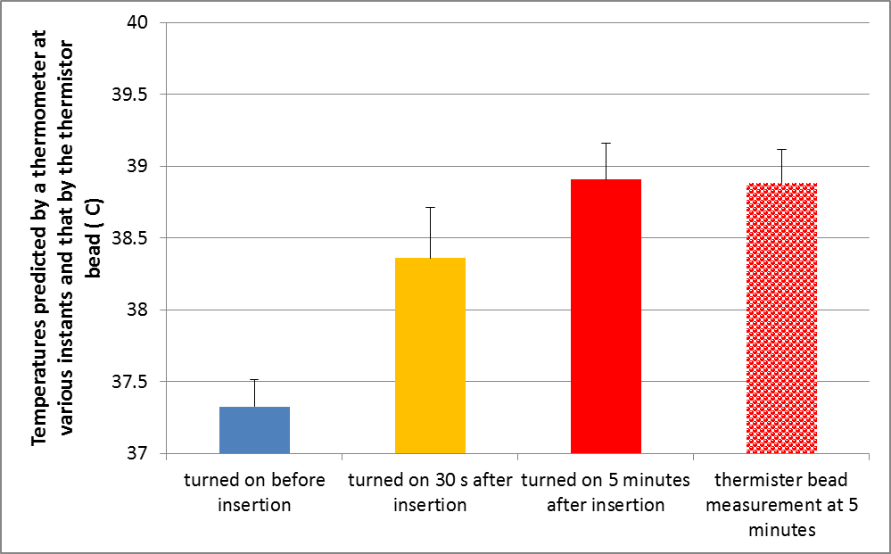
How To Improve?

